Slide 1

SPROCKET CENTRAL PTY LTD data analysis
Presented by Kolawole Adeyanju

Slide 2


Agenda
Introduction
Data Exploration
Model Development
Interpretation

Slide 3

Introduction
The presentation aims to analyze the existing customer dataset, model, and interpret the data to understand what customer base should be targeted for value-based marketing by Sprocket Central Pty Ltd.

Slide 4



DATA EXPLORATION
AGE DISTRIBUTION
GENDER DISTRIBUTION
PROFIT DISTRIBUTION BY INDUSTRY
SALES DISTRIBUTION BY WEALTH SEGMENT
SALES DISTRIBUTION BY BRAND

Slide 5
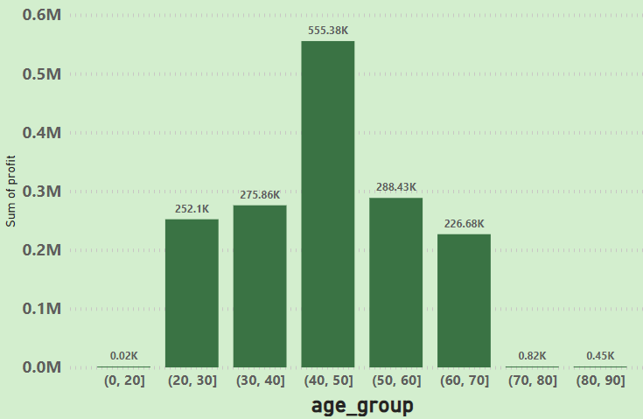
AGE DISTRIBUTION OF CUSTOMERS

Slide 6
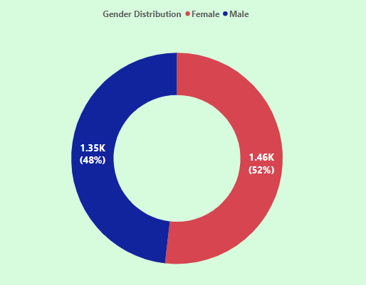
GENDER DISTRIBUTION OF CUSTOMERS

Slide 7
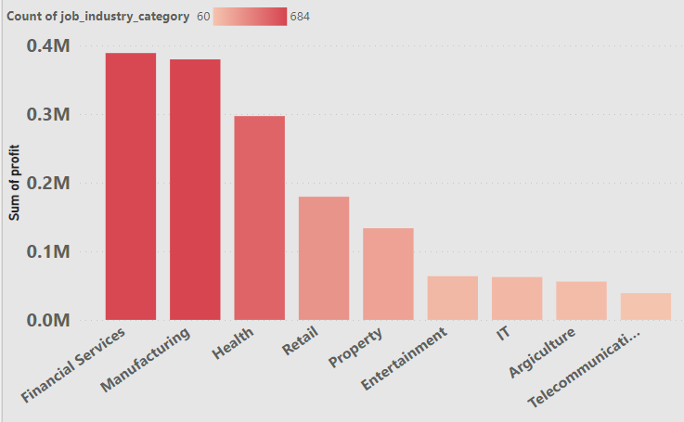
DISTRIBUTION OF PROFIT BY JOB INDUSTRY

Slide 8
DISTRIBUTION OF PROFIT BY JOB INDUSTRY

Slide 9
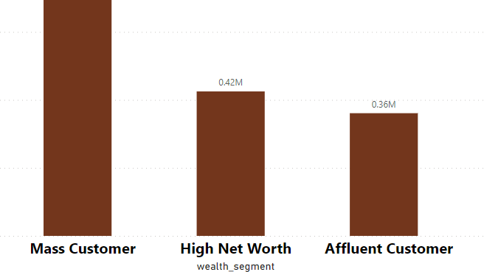
DISTRIBUTION OF PROFIT BY WEALTH SEGMENT

Slide 10
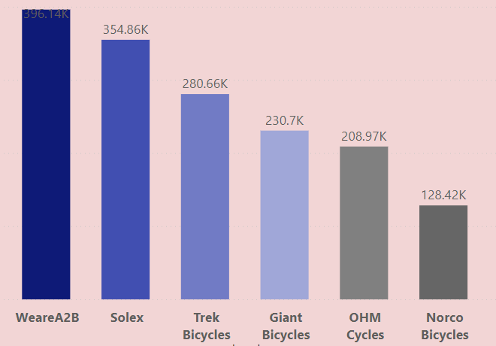
DISTRIBUTION OF PROFIT BY BRAND

Slide 11

Model analysis

Slide 12
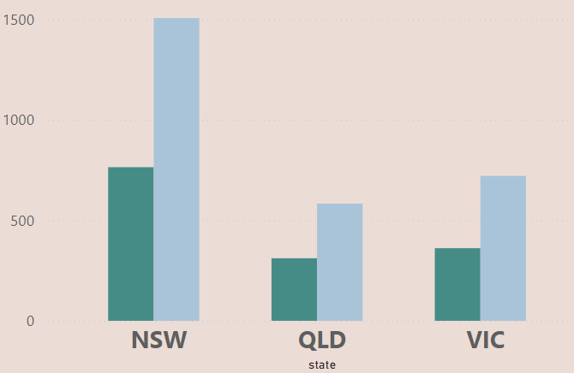

DISTRIBUTION OF PROFIT BY BRAND

Slide 13
Summary

Slide 14



interpretation
Target Mass Customers for Marketing
Target sales of
WeareA2B, Solex, and TrekBicycles
Target customers from NSW State without cars
Pay attention to the health and manufacturing job industry customers

Slide 15


Thank you
KOLAWOLE ADEYANJU

